Slide 1
SOSA Team Officials Meeting May 6th, 2019

Slide 2
Agenda
Introduction
Communications
Schedules
Team Section- Website
Unlimited Rosters
Discipline
Retreat Line
Questions

Slide 3
Communication Model
Inbound
Outbound
Parents & Players
Team Officials
Club Rep
General Manager
Directors
Directors
General Manager
Coach (cc Club rep/president)
Parents & Players
Questions, Complaints, concerns and other matters must be communicated to the appropriate club representative.
DO NOT RESPOND TO EMAILS FROM THE WEB SITE GENERATOR

Slide 4
Getting ready for the new season
The SOSA League operates extensively via the website and email.
To prepare your team for the season you need to:
Activate your account
Ask up to 3 team officials to also activate their accounts
Enter your team roster, DOB and SEOS#
Enter your staff that may be on the bench (max 4)
Enter your players shirt #’s
Familiarize yourself with the website tools

Slide 5
Managing your Schedule

Slide 6
Schedules
Draft schedule will be made available by Friday May 10th
Please review your teams schedule and report any issues to admin@sosaleague.ca
Between May 10th and May 14th we will correct the draft schedule
Final schedule released May 15th- no changes possible after this date
The rules for requesting changes to the schedule are covered in the next slides
Changes will occur over the next week as problems are identified- So continue to check your schedule
Please pay special attention to the game fields and game nights-they may vary from your usual
Season will start May 20th – pending fields opening

Slide 7
Your Schedule
YOU are responsible for managing your schedule

Slide 8
Reschedule Requests
A team is permitted one (1) reschedule per season according to the following procedure:
Please Review Rescheduling Process in 4 below
No weekend games can be rescheduled. Changes to weekend games can be made for any reason prior to the first day of the season.
Requests for Team Choice reschedules must be made before August 1st of each season. Scheduled games after August 1st can be rescheduled, but they must be rescheduled prior to August 1st.

Slide 9
Arranging a rescheduled Game
The rescheduled game shall be rescheduled within 14 days of the approval of the request to reschedule and must be played before the division end-of-season date as defined in the Bylaws. The last two (2) regularly scheduled games must be played before the originally scheduled game date. Note: Teams may not accept or schedule another game on the same day they had previously asked to have their game to be re-scheduled.
When a game is rescheduled for any reason the SOSA League will appoint one of the teams as being responsible to complete the reschedule process. Under normal circumstances the following shall apply without the SOSA League notifying the teams:
Request to Reschedule – Team Choice or Other Reasons -the team requesting the reschedule shall be responsible for rescheduling; or
Reschedule by the League -the Home team shall be responsible for rescheduling.
The teams work together to agree on a date. At a minimum, the Home team is required to provide three (3) for the Away team to choose from.

Slide 10
Rescheduling- Con’t
Once the game is agreed upon:
The Home team then sends an email to the Away team with the details: game number, new game date, home team, away team, field, start time.
The Away team forwards the email to the league at admin@sosaleague.com (cc the Home team). The SOSA League now has confirmation from both teams that the date is acceptable.
Rained out games must still be rescheduled. The league will add a new game number to replace the rained out game. The same rescheduling process will apply for rescheduling.
***Note: If this process is not followed the game will not be scheduled/rescheduled. ***

Slide 11
End of Season date
The end of season date is Sunday September 1st, 2019
No games will be played after this date except for games postponed or abandoned within 7 days of the end of the season date
The outcome of any un-played games will be decided by the league

Slide 12
Team Section - Website

Slide 13
Team Section
Once you log into the website as Team staff there will be many things you can do and need to do. We’ll cover the essentials:
Game sheets: Print game sheets
Suspensions: view suspensions
Game report: complete game reports
Playing up permit: request/ cancel/ see status of PuP’s
Add to squad: add players to team
Modify squad: modify player info
Delete Player: delete a player
Shirt numbers: update to show on gamesheets
Player privacy: individually select the privacy level for a player
Modify scorer: modify scorer for a game
Modify shutout: modify who got the shutout
Change Uniform: change uniform colours
Request Reschedule: request a rescheduled game

Slide 14
Players and Staff
Players and team staff are entered on the website so they can be printed on the game sheet
The SOSA league is required to verify players and staff are eligible to play
To be eligible to play, both players and staff must be registered with OS
Anyone listed on the game sheet is deemed to have played in the game
It is your responsibility to ensure only registered players and staff are on the game sheet

Slide 15
Playing Up

Slide 16
Playing Ups
Details on who is eligible are contained in the rules and regulations
It is your responsibility to ensure that the player you request to play up meets the eligibility requirements
If you play a player who is ineligible it will result in a disciplinary hearing
Only players typed on the game sheet are eligible to play
No additional PuP form is required as the play up is printed and identified on the game sheet
The exception for handwritten names are for Temporary Eligibility Permits (TEP) (playing from club to club) or Trial Registration Permits (TRP) and obtained from District association

Slide 17
Playing Up – Development
A player registered in the Under-8 to Under-12 age classifications may play for a team in a higher age classification only under one of the following conditions:
a player registered in the Under-8 age classification may play up to an Under-9 aged team
a player registered in the Under-9 age classification may play up to an Under-10 aged team
a player registered in the Under-10 age classification may play up to an Under-11 aged team
a player registered in the Under-11 age classification may play up to an Under-12 aged team
Providing that:
the player is playing for a team within the same Club
written permission from the Club's Technical Director or Club Head Coach has been submitted to the District Association
A player registered in the Under-7 or younger age classification may not play up to an older aged team.
A player who is registered to a team in a higher birth year may NOT play for a team in their own birth year. I.e. U10 player who is registered and playing U11, may not be called down to play U10 even though they meet the age requirements.

Slide 18
House League Call-ups
House league players to be used as Call-ups through the website
Added by Club Administrator
Once added they will be available for team to as call-ups
Once a team has requested PuP, an email will be sent to Club Reps
The club rep will login and approve or decline the PuP-some clubs have internal rules for approval; the league will not approve PuP’s
If it is approved the player will be printed on the gamesheet and eligible to play

Slide 19
Playing Up Permits

Slide 20
Playing Up Permits
House League Selection
Click next
In the next window, click Submit and an email will be sent to the Club Rep

Slide 21
Playing Up Permits
The approval status is displayed for the coach

Slide 22
Playing Up Permits
Game Sheets will List Play up Players

Slide 23
Game Sheets

Slide 24
Game Sheets
Before each game you have to create a set of 3 game sheets
These are only available via the website
The game sheet is an official document of the game so please ensure you complete the form accurately and completely, and make sure the referee also completes their section accurately.
Initial having done card check
ALL bench staff shall sign the game sheets
If staff or players are not on the game sheet they cannot be on the bench
If players or bench staff are absent, please cross them off the game sheet
Give the game sheets to the referee at least 15 minutes before kickoff.

Slide 25
Game sheets- Select the Players
Select players for the game sheet
Note: PuP player will now be shown
If you do not require the PuP you will need to go to the PuP page and delete them
DO NOT add PuP to your roster

Slide 26
Game sheet- Select the Staff
Only 4 staff can be on the game sheet and on the bench
However, You can have more than 4 staff sign up for your team

Slide 27
District Development- Unlimited Rosters

Slide 28
Unlimited Rosters- Input
All players in the U9-U12 age groups must be input but a Club Administrator through the Club section of the website
Number of games players have played will be tracked

Slide 29
Team View- Generate Game Sheet
Teams Generate Game Sheet as they normally would

Slide 30
Choosing Players
Choose which players you will have on your game squad
Players with an X means they are already chosen for a game that night
Teams are restricted to 14 players max

Slide 31
Completing Game Sheet
Choose which team officials need to appear on the game sheet
Click next

Slide 32
Game Sheets
Click on create game sheet

Slide 33
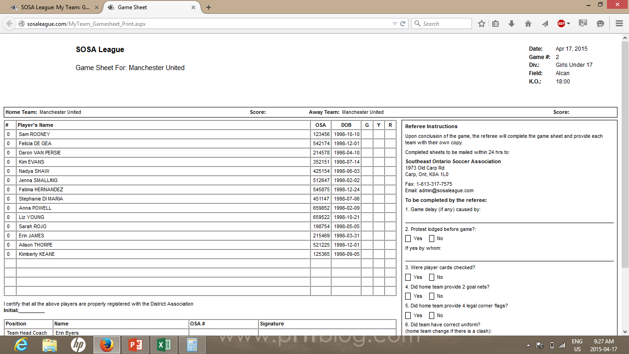
Game Sheet
Players and their details are now listed
Jersey numbers will have to be entered for each game

Slide 34
Player Book

Slide 35
Player Book Inspections
Player book inspections are NOT optional and MUST be carried out before kick off of every game
If a player does not have their Player Book, they are ineligible to play
Any issues, have the referee mark them on the game sheet, make sure you get a copy at the end of the game, scan and email it to sosasoccer@bell.net or it can be dropped off at the District Office
You cannot stop a player from playing, however, issues noted on the game sheet will be investigated by the SOSA League and will lead to discipline as required

Slide 36
Team Staff Id Cards
Ontario Soccer requires that all team officials have an ID card/Book
Clubs, not SOSA League, are responsible for selecting capable team staff for each game.

Slide 37
Game Sheets
Game sheets have been modified to list the card Offences
The Referee will indicate on the game sheet the offence so the players coaches will know what the potential discipline is
Serious foul play
Violent conduct
Spits at the opponent
Denies an obvious goal scoring opportunity by hand ball
Denies an obvious goal scoring opportunity by foul
Offensive or insulting language/gesture
Receives a second caution
Hearing requests must be submitted within 72 hours
Any coach ejected during a game will also have 72 hours to as for a hearing – DO NOT return to the field.

Slide 38
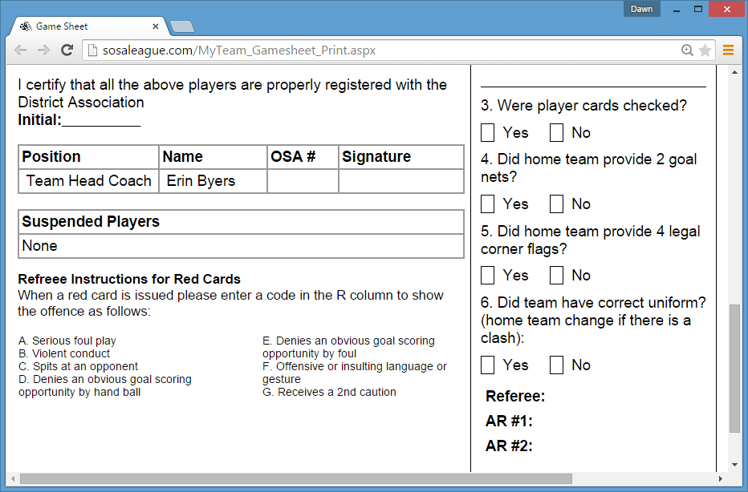
Game sheets and Discipline

Slide 39
Game Reporting
Following the game, collect your copy of the game sheet from the referee
Use this report to enter the game report via the web site
You must submit your report within 24 hours
So if your result is missing don’t contact the league – contact your opponent

Slide 40
Game Reporting Rule
In the past many have been negligent in reporting game results so there is a rule:
Each Coach shall be responsible for entering the game report, including the score, cards issued by the Referee as well as the game feedback on the SOSA League website within twenty-four (48) hours of completion of the game. If the game report is not entered within seven (7) days, the League will utilize the game sheet received from the Referee to complete the game report.

Slide 41
Protests
If you wish to play a game under protest you must inform the referee prior to kick off and ask him to indicate it on the game sheet
Following the game you must submit the protest fee of $50.00 within 48 hours
You will be notified if your protest is valid or not
No protests pertaining the decision of the game official shall be entertained
Objections to field condition, goalposts, balls or team colours will not be considered as grounds for protest

Slide 42
Discipline

Slide 43
Discipline
Ontario Soccer discipline policies and procedures are used by SOSA League
There are 2 Processes:
Discipline by Review (DBR)
Discipline by Hearing (DBH)
Following a red card the player can request a hearing within 72 hours of the game, otherwise a discipline by review occurs
The League may also request the individual to attend a hearing
Coaches need to be reminded that regardless of age – players and parents are their responsibility

Slide 44
Discipline by Review (DBR)
The SOSA League discipline Committee will review all red and yellow card reports and issue a suspension according to Ontario Soccer policy.
You can not appeal the outcome of a DBR decision.
In 2019, SOSA League will use the DBR.

Slide 45
Discipline by Hearing (DBH)
Discipline hearings when required are held in Kingston
The hearing dates for 2019 will be posted under the discipline section of the website
At least 3 people will sit on the panel
You will have to pay a $50.00 fee to request a hearing. It is only returned if the individual is found not guilty
You can appeal the outcome of a DBH decision to the District.

Slide 46
Suspensions
The league will tell you when a player is suspended
Do not sit out a player and then expect that to count in a suspension
A coach will receive email notification of a suspension and given instructions for how he can retrieve the letter from the web site
The game sheet will also indicate all suspended players on your team
Where disciplinary action results in suspension, the suspension shall not commence prior to 7 calendar days from the issue of the notice of discipline
Example: a player is issued a suspension notice on Friday would serve the suspension for the game(s) scheduled on or after the following Friday

Slide 47
Retreat Line

Slide 48
Retreat Line
SOSA League will be using the Retreat Line for U9 to U12 in 2019.
Options for Goalkeepers - 7v7/9v9
When the goalkeeper has the ball at a goal kick or after making a save the opposing team members would "retreat" to the predetermined area of the field.
The predetermined areas are as follows:
7v7 – 1/3rds line
9v9 - 1/3rds line
With the opposition retreating to the correct part of the field the goalkeeper can now successfully throw or pass the ball to a team mate.

Slide 49
Retreat Line
Once the player receiving the ball from the goalkeeper receives the ball, the ball is in play and the opposition players can pressure and attempt to win the ball.
If the goalkeeper chooses not to wait for the opposing players to "retreat" and throws or passes the ball down the field, the ball is instantly in play and does not require a player from the goalkeeper’s team to touch the ball first.
The ball is in play once it leaves the penalty area All opponents must be behind the retreat line and cannot cross the retreat line until the ball:
Is touched by a player of the team taking the goal kick OR,
Leaves the field of play OR,
Goes over the retreat line. (If the goalkeeper chooses to play the ball across the retreat line prior to the opposition crossing the retreat line)
More information can be found on the SOSA League website under About Us

Slide 50
Rules Review for 2019
Infringements and Sanctions For any infringements included below, the kick-off is retaken.
Players not in their own half
Opponents encroaching within five (5) metres (or six (6) yards) of the ball
Players encroaching into opposing half
Ball not on center mark or clearly moved
Kick-off taken before signal
Kicker touches the ball a second time with their feet
The kick-off procedure is re-started with an Indirect Free Kick if the kicker:
Touches the ball a second time with their hands

Slide 51
Rule Review for 2019
Infringements and Sanctions
The ball is dropped again:
If it is touched by a player before it makes contact with the ground
If the ball leaves the field of play after it makes contact with the ground, without touching another player
An Indirect Free Kick is awarded for the opposing team:
If the player touches the ball with their hands

Slide 52
Rule Review for 2019
An indirect free kick is awarded to the opposing team if a goalkeeper, inside his/her own penalty area, commits any of the following three offences:
P. Handles the ball for more than 6 seconds before releasing it from his/her possession
Q. Handles the ball after it has been deliberately kicked to him/her by a team-mate
R. Handles the ball after receiving it directly from a pass-in/dribble-in taken by a team-mate.
A re-take is awarded if the goalkeeper:
S. Handles the ball again, from inside their penalty area, after releasing it from his/her possession

Slide 53
Rule Review for 2019
Infringements and Sanctions
For any infringements included below, the free kick is retaken.
Opponents encroaching within 5 metres (or six (6) yards) of the ball
Kicker touches the ball a second time with their feet
The ball is not kicked directly out of the penalty area
An Indirect Free Kick or Penalty Kick is awarded to the opposing team if the kicker:
Touches the ball a second time with their hands

Slide 54
Rule Review for 2019
A pass-in or dribble-in is a method of restarting play. The kicker may conduct either as a method of restarting play throughout the duration of the match.
A pass-in or dribble-in is awarded to the opponents of the player who last touched the ball when the whole of the ball crosses the touch line, either on the ground or in the air.
A goal cannot be scored directly from a pass-in/dribble-in. A goal can be scored from a dribble-in only if the kicker touches the ball a second time with their feet or a pass-in if the ball touches another player before entering the net and considered as a goal.

Slide 55
Rule Review for 2019
Infringements and Sanctions
For any infringements, including those listed below, the pass-in/dribble-in is retaken.
Opponents encroaching within 3 metres (or three (3) yards) of the ball
An Indirect Free Kick or is awarded to the opposing team if the kicker:
Touches the ball a second time with their hands

Slide 56
Rule Review for 2019
Infringements and Sanctions
For any infringements, including those listed below, the free kick is retaken.
Opponents encroach the retreat line before it is touched by a player of the team taking the goal kick
Kicker touches the ball a second time with their feet
The ball is not kicked directly out of the penalty area

Slide 57
Rule Review for 2019
Infringements and Sanctions
For any infringements, including those listed below, the corner kick is retaken.
Opponents encroaching within 5 metres (or six (6) yards) of the ball
Kicker touches the ball a second time with their feet
An Indirect Free Kick or is awarded to the opposing team if the kicker:
Touches the ball a second time with their hands

Slide 58
Final Standings – Tie Breakers
If two or more teams in an Age Group are tied in points at the end of the League schedule, then the tie-breaker to determine the team standing shall be determined in the following order:
The team with the most points in the head-to-head games played between the tied teams shall be declared the winner of the tie-breaker;
The team with the highest goal differential (GF minus GA) in the head-to-head games played between the tied teams shall be declared the winner of the tie-breaker;
The team with the most wins in all regular season games shall be declared the winner of the tie-breaker;
The team with the least goals against in all regular season games shall be declared the winner of the tie-breaker;
If the position is relevant for determining the division champion or the team’s eligibility for promotion to a higher level league or division, and if steps a), b), c) and d) do not break the tie, a playoff shall be required between the tied teams, to be played at a neutral site under the direction of the SOSA League (e.g. referee and assistant referees appointed by SOSA League). The game duration shall be the same as specified in these Rules and Regulations for the Age Group of those teams. If the game is tied at the end of regular time, then the game shall be decided by penalty kicks.

Slide 59
Trial Registration Permit vs Temporary Eligibility Permit
This Trial Registration Permit requires validation by the Club’s District Association or Ontario Soccer where applicable. (Note: The player also requires an Ontario Soccer Registration Identification” in order to play for a Competitive Team. Section 5.0 Registration – Operational Procedure 8.0
A “Trial Registration Permit” is a temporary registration with Ontario Soccer which shall only be used by players who are not registered with Ontario Soccer or a Provincial Association affiliated to the CSA.
Date of Game #1: Date of Game #2:
This Trial Registration Permit Form will be used for a: ☐ League Game:
☐ Tournament Game:
☐Exhibition Game: v.
PLAYER INFORMATION
Player Name:
Address: City: Prov. Postal Code:
Telephone: Email:
Date of Birth (d/m/y): Citizenship Status:
ORGANIZATION /TEAM INFORMATION
Organization wishing to use the above player in a trial game(s): Click here to enter text.
Team for which the player will play on trial with: Click here to enter text.
Authorization of Club Registrar:
Name Signature Date
Club with which player was last registered:
Country in which player was last registered:
Year in which player was last registered:
WARNING: Any person providing false information or withholding the required information in this section shall be suspended from all soccer activities for one year.
PLAYER’S AGREEMENT
I have not registered with any other team in Ontario for this season. I understand that after this form has been validated by the District Association, I will be registered with Ontario Soccer for two trial games during the “Trial Period” indicated and only with the team specified on this form. During the “Trial Period” indicated on this TRP form, I am eligible for Ontario Soccer insurance and am subject to the discipline of Ontario Soccer. I agree to abide by the Governing Documents of Ontario Soccer its District Associations, Leagues and Clubs/Academies.
15-DAY TRIAL PERIOD
Starting Date:
Expiry Date: DISTRICT ASSOCIATION / ONTARIO SOCCER VALIDATION
APPROVAL:
Trial Registration Permit – this permit is to be used when a player is not registered in the current season to any team. They will be having a “tryout” to your team to see if both parties are interested in playing together.
Temporary Eligibility Permit – this permit is to be used when a player is currently registered to a club (Quinte West) and another club would like to borrow them for a game or tournament (Belleville).
Both permits must be signed off by the club and District Association.
Please visit the SOSA District website for more information.
http://www.soccersosa.com/DisplayPage.aspx?PageID=297

Slide 60
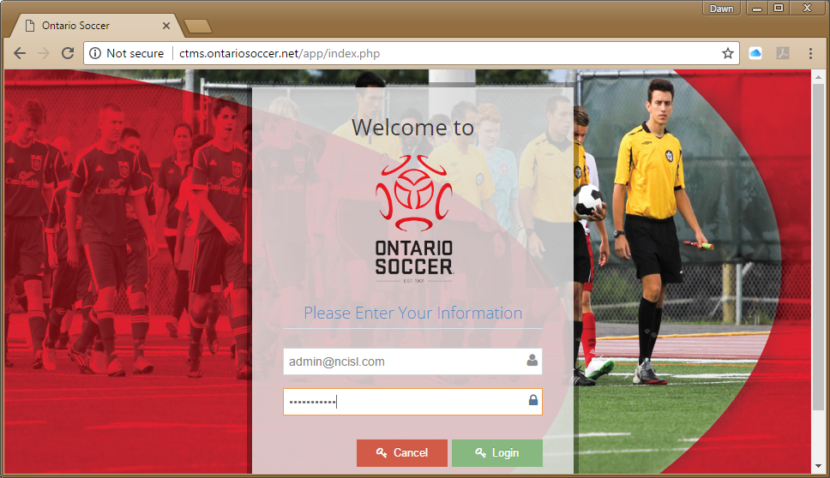
Travel Permits & Tournament Applications
http://ctms.ontariosoccer.net/

Slide 61
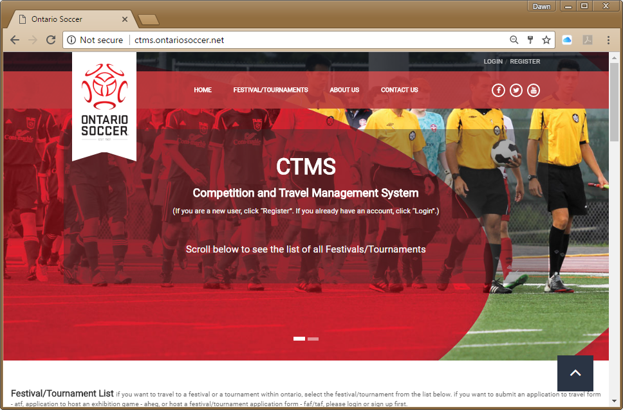
CTMS – Ontario Soccer Management System
Accounts can be created quickly by clicking here.
If you already have an account click Login.

Slide 62
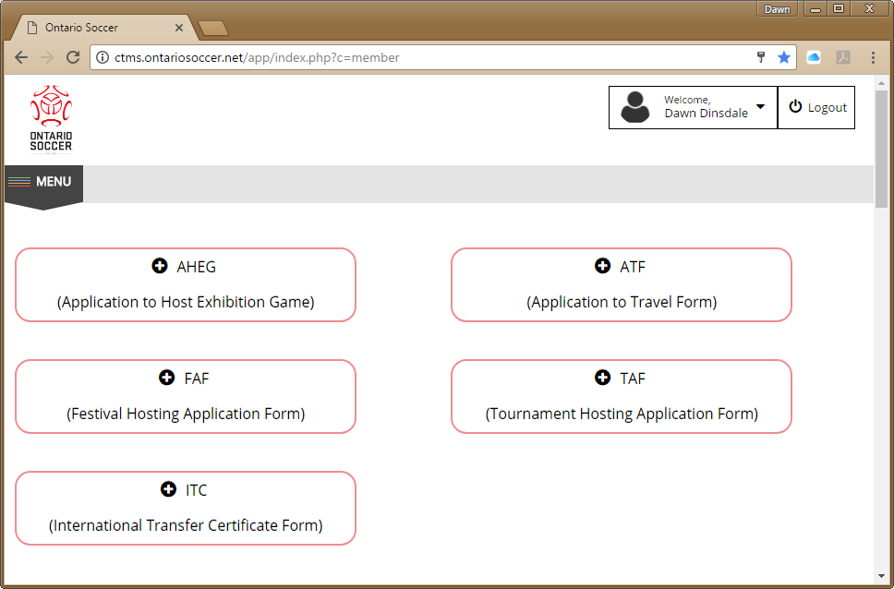
Options to Choose
Application to Host Tournament, Travel Permission, Festival hosting etc.

Slide 63
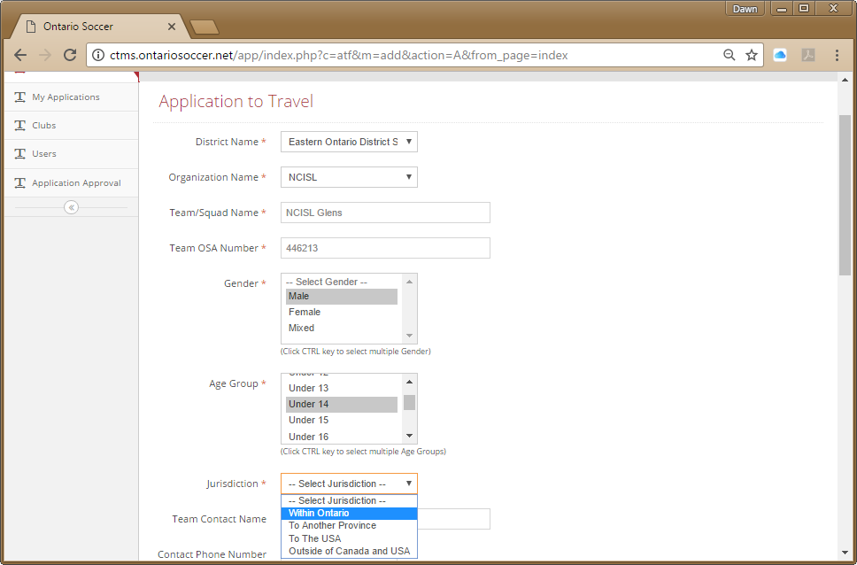
Application to Travel
Your District Association will already be selected.
Choose your club, Team Name, Team OS Number, Gender, Age Group and Jurisdiction (Ontario or other province/Country)
Enter Contact information.

Slide 64
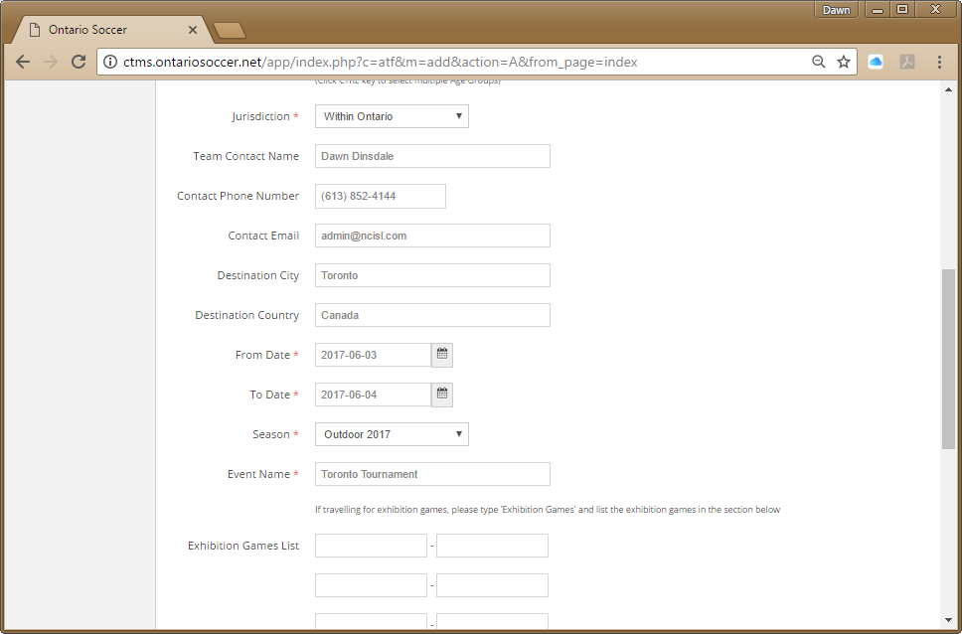
Travel Permits
Enter tournament destination, tournament dates and name.
Fill in the exhibition games dates if you are traveling for exhibition games.

Slide 65
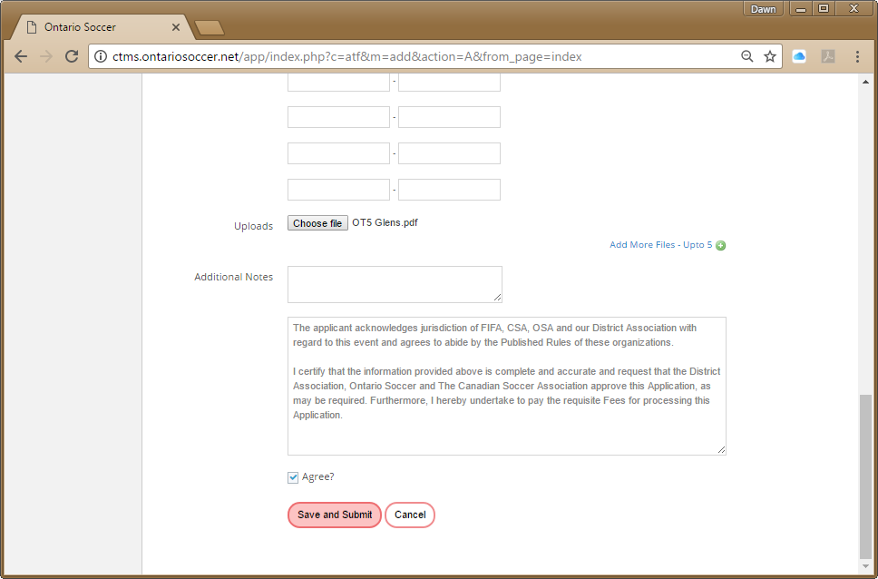
Travel Permits
Upload any files that maybe required.
You can upload a total of 5 files
Read the disclaimer and click Agree.
Save and Submit

Slide 66
Summary of Fines
NSF Cheque | $50 plus Bank Charges
Failure of a Team Head Coach to produce OS Player Registrant Books | $50 per occurrence
Failure to provide a gamesheet generated from the System (if no notice of technical difficulties) | $50 per game
Hand writing names on games sheets (if no notice of technical difficulties). | $50 per game
Team playing an ineligible player | $100 per player per game
Failure of a Team to attend the Team's Pre-Season meeting. | $50 per team
Failure to activate the Team on the SOSA League Management System by April 30 | $50 per team
Failure of a Team to produce alternate Team colours when directed to do so by the Referee | $50 per occurrence
Team playing an ineligible or suspended player under the name of one of its other registered players | $1500
Failure of team(s) to reschedule a game by end of season or game not being played | $50 per occurrence
Team Official present at or in the vicinity of the field for that team’s League game during the period of his/her suspension. | $50 per occurrence
Failure to provide, goal nets or, game ball or corner flags | $25 per occurrence

Slide 67
Summary of Fines
Player, Coach or other Team Official who attempts or does impede, harass or otherwise intimidate a game official or opposing Team Officials | up to $1000
Any substitute player or Team Official on the bench entering the field of play during an altercation | up to $500
Team caused scheduled kick-off of game to be delayed | $25
Team failing to appear for a game or have at least 7 players on the field within the 20 minute grace period
First Occurrence | $200
Second Occurrence | $400
Third Occurrence | termination of the Team's membership in the League
Game abandoned due to actions of players, Team Officials or spectators/supporters of a Team | up to $1000
Team refusing to play an opponent | $500
Game abandoned or because a team is unable to field the minimum number of players at any time after the start of the game | $100
Team removes itself from the field of play | $250
Unauthorized rescheduling of a game by team Officials | $100

Slide 68
Questions??
Questions??

Slide 69
HAVE A GREAT
SEASON

